Slide 1

Enceladus

Slide 2

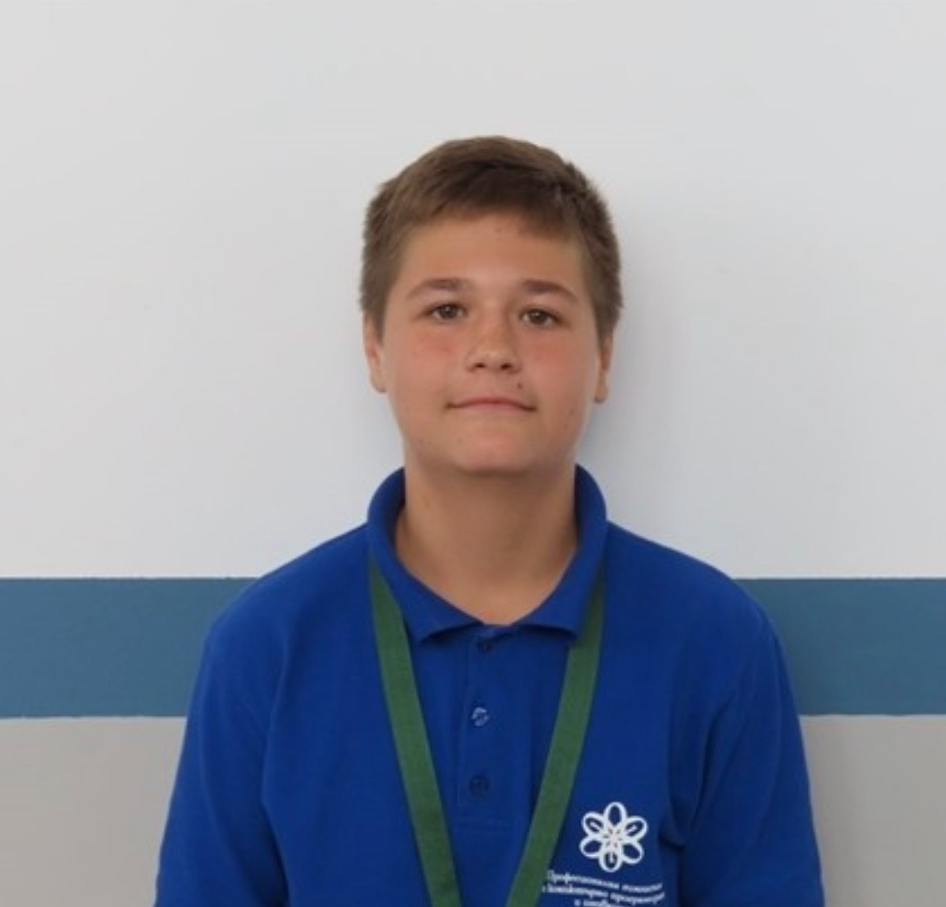
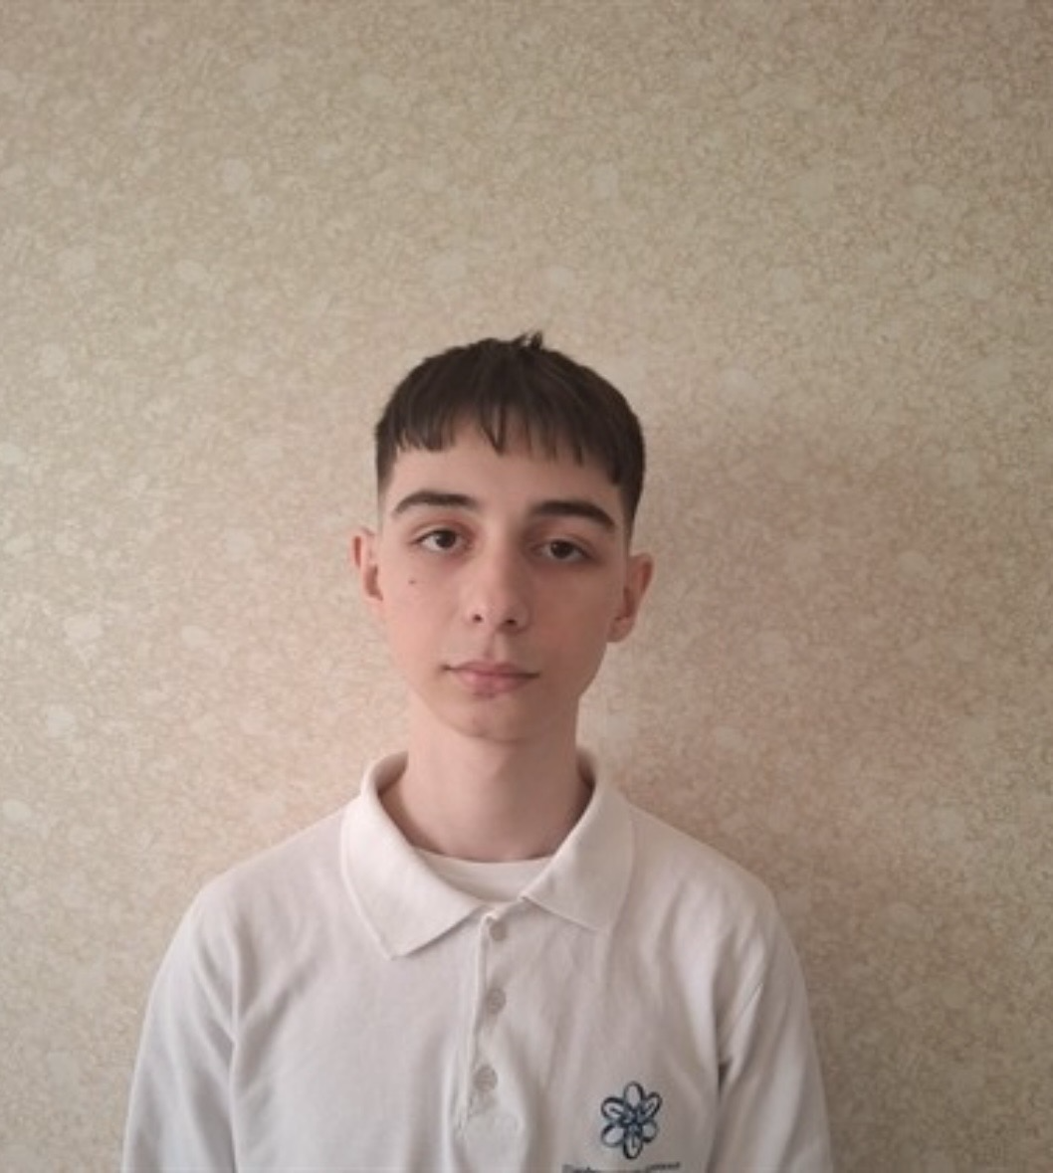
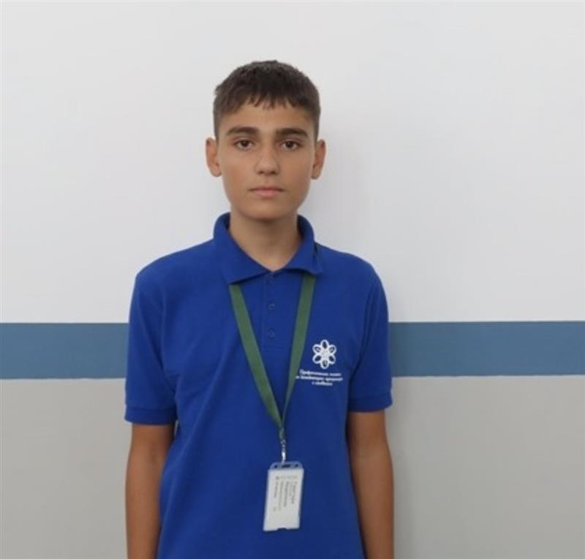
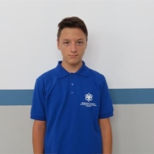
OUR TEAM
Daniil Moldovanov - Scrum trainer
Hristiyan Grozdev - Frontend Developer
Grigori Nedyalkov - Backend Developer
Dimitar Dimitrov - Designer

Slide 3

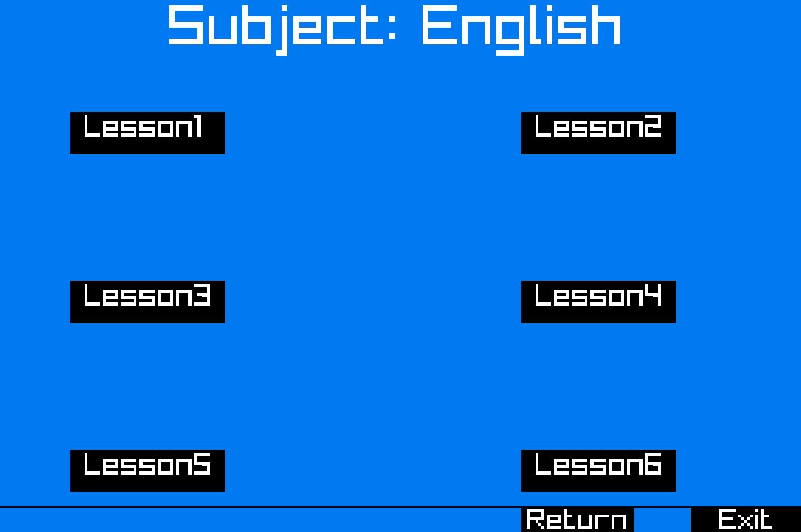
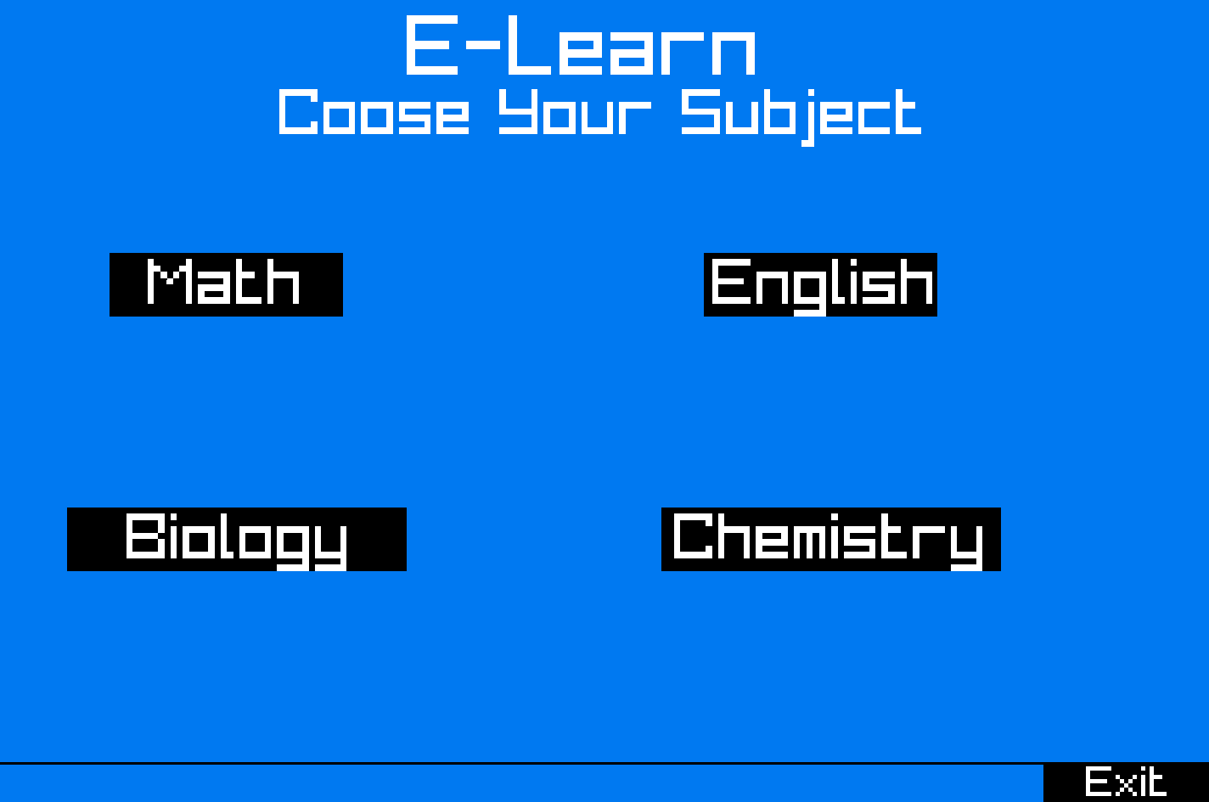
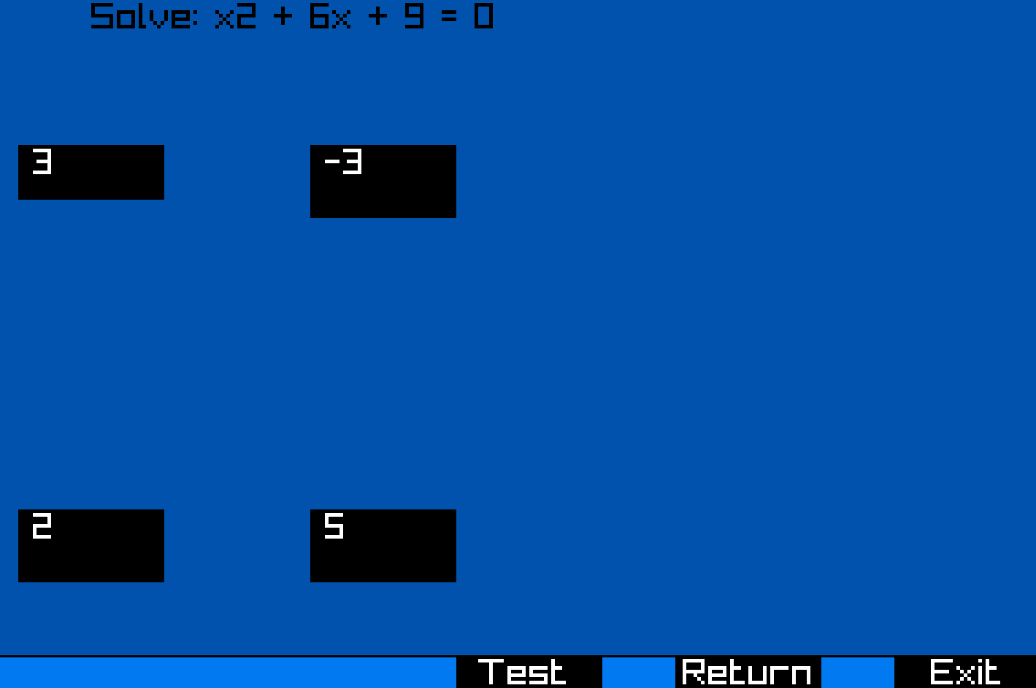
Idea

Slide 4








Programs we used

Slide 5




Stages of creation
Choose an idea
Make an application
Make a design
Make documentation

Slide 6
Let’s see our application

